Slide 1
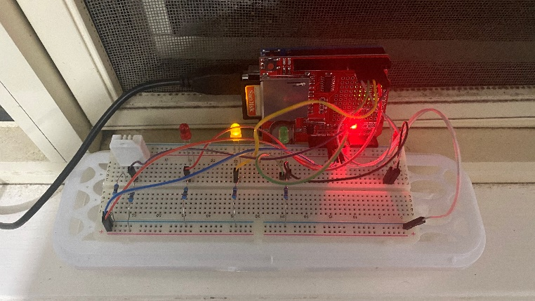
Monitoring Outside Temperature and Humidity Levels from Inside
Ben Marriner (220253518)
Deakin University Burwood
Introduction
Software
Results
Melbourne is notoriously known for having rather unpredictable weather patterns. The prototype presented here aims to make it easier for people to monitor the weather from the outside in their own home. More specifically, they can monitor the temperature and humidity levels. The prototype was designed to see if there was link between high humidity levels and if rain. The hypothesis was that if humidity levels were above 70%, this would act as a sign that it was about to rain. However, this hypothesis could not be proved because there is no link between humidity and rain. It can rain regardless of humidity levels. While the hypothesis could not be proven, the prototype can nonetheless monitor temperature and humidity levels and still be able to tell the user that they are at a certain level using the LEDs.
Sense
Prototype senses temperature and humidity levels
Think
Temperature and humidity levels are recorded into CSV files on the SD card if one exists in the slot. Based on the levels it has sensed the software works out which LEDs turn on and off.
Act
The prototype turns on LEDs based on the following rules:
Red LED: Temperature is below 14°C
Yellow LED: Temperature is 14°C or higher and below 20°C
Green LED: Temperature is 20°C or higher
Second Red LED: Humidity is at 70% or higher
The following graphs summarise data collected over two days. The prototype sampled data from the 20th of October 2020 at 12:00AM to the 21st of October 2020 at 11:59PM.
The temperature graph shows the temperature levels over the two days and also shows which LED would have been turned on at that time using the colour of the graph. The humidity graph shows the humidity levels over the two days. The more opaque the colour, the higher the moisture levels in the air.
Materials
Finished Prototype
Component | Qty
Arduino UNO | 1
SD Card (16GB) | 1
Breadboard | 1
DHT Sensor | 1
Red LED | 2
Yellow LED | 1
Green LED | 1
Red LED
Yellow LED
Green LED
SD Card
Arduino
DHT Sensor
Humidity LED
USB Cable
Breadboard

